Slide 1
Types of Computers
Created by: Baratelia Timur Gerasenkov Ilya Group: 221-352

Slide 2
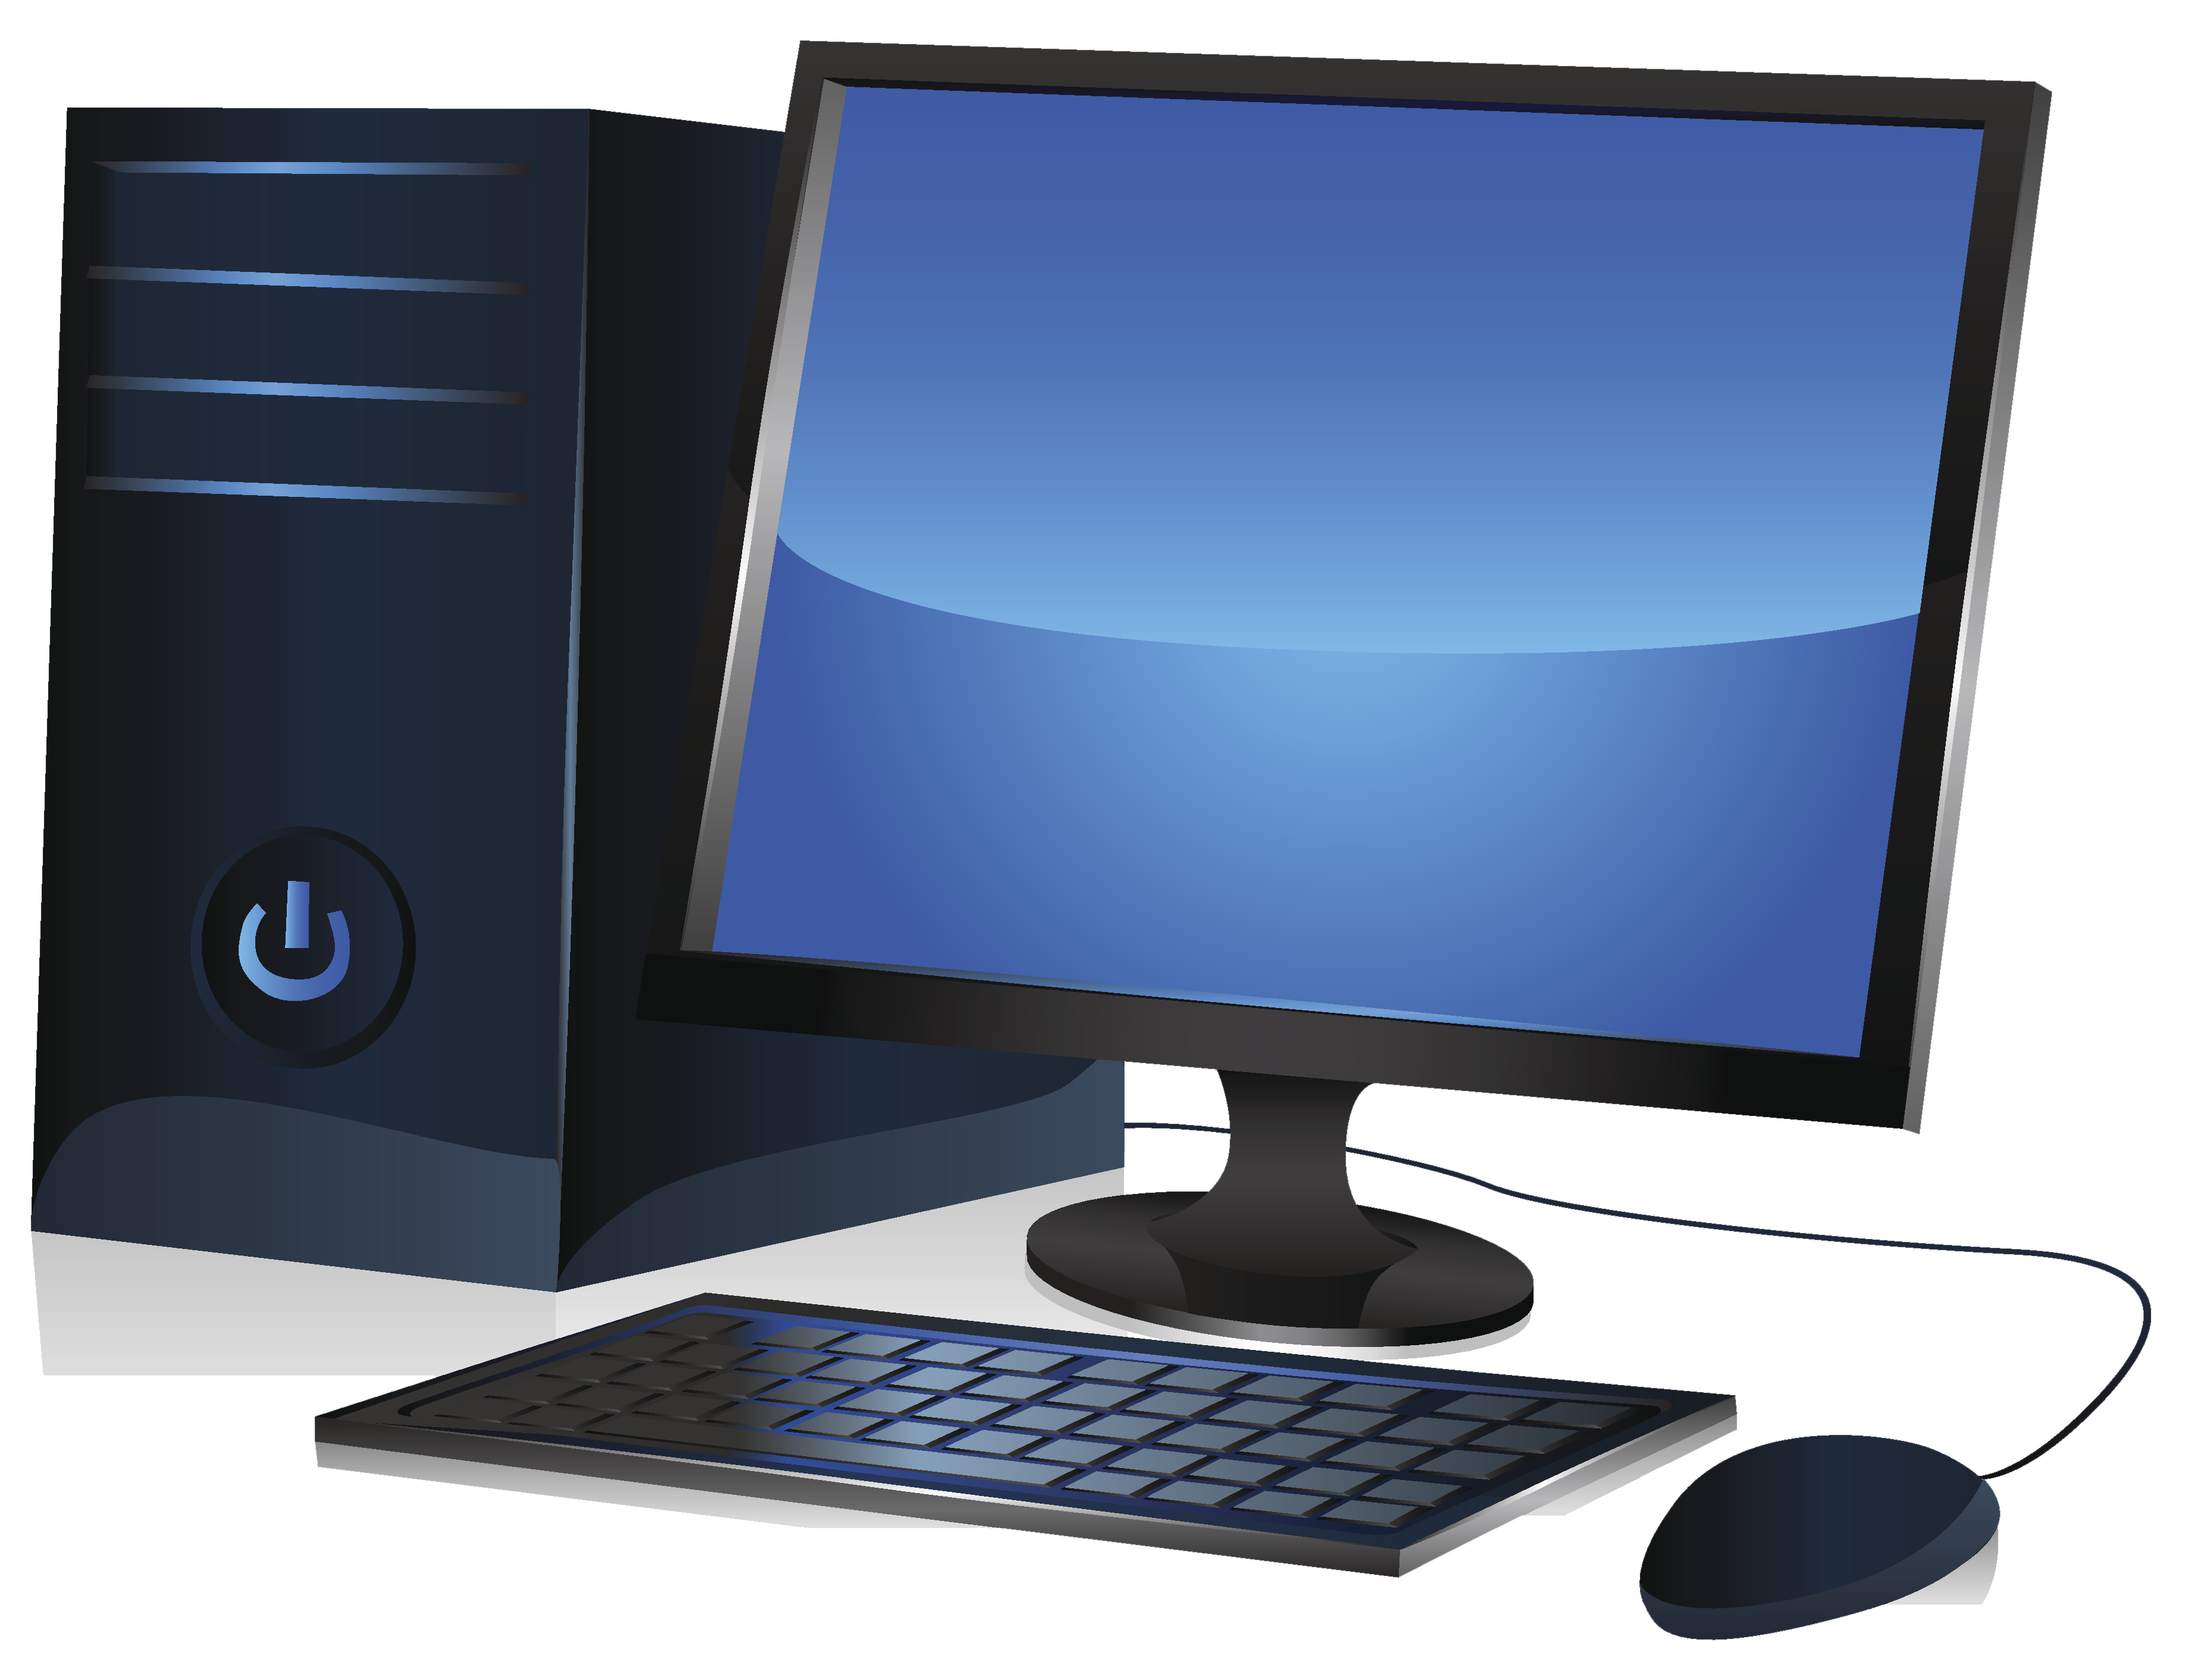
Personal Computers (PCs)
Personal Computing Power

Slide 3
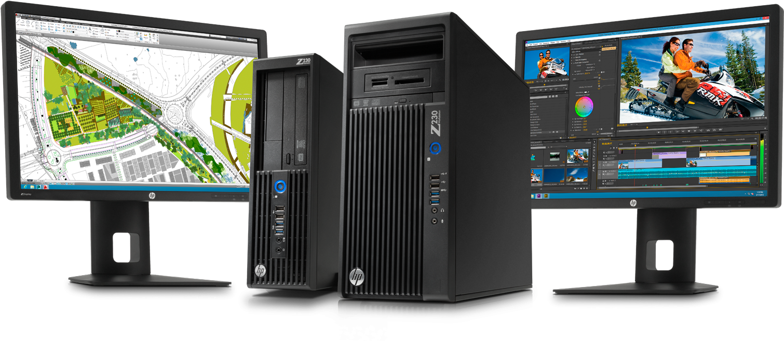
Workstations
Power and Precision

Slide 4
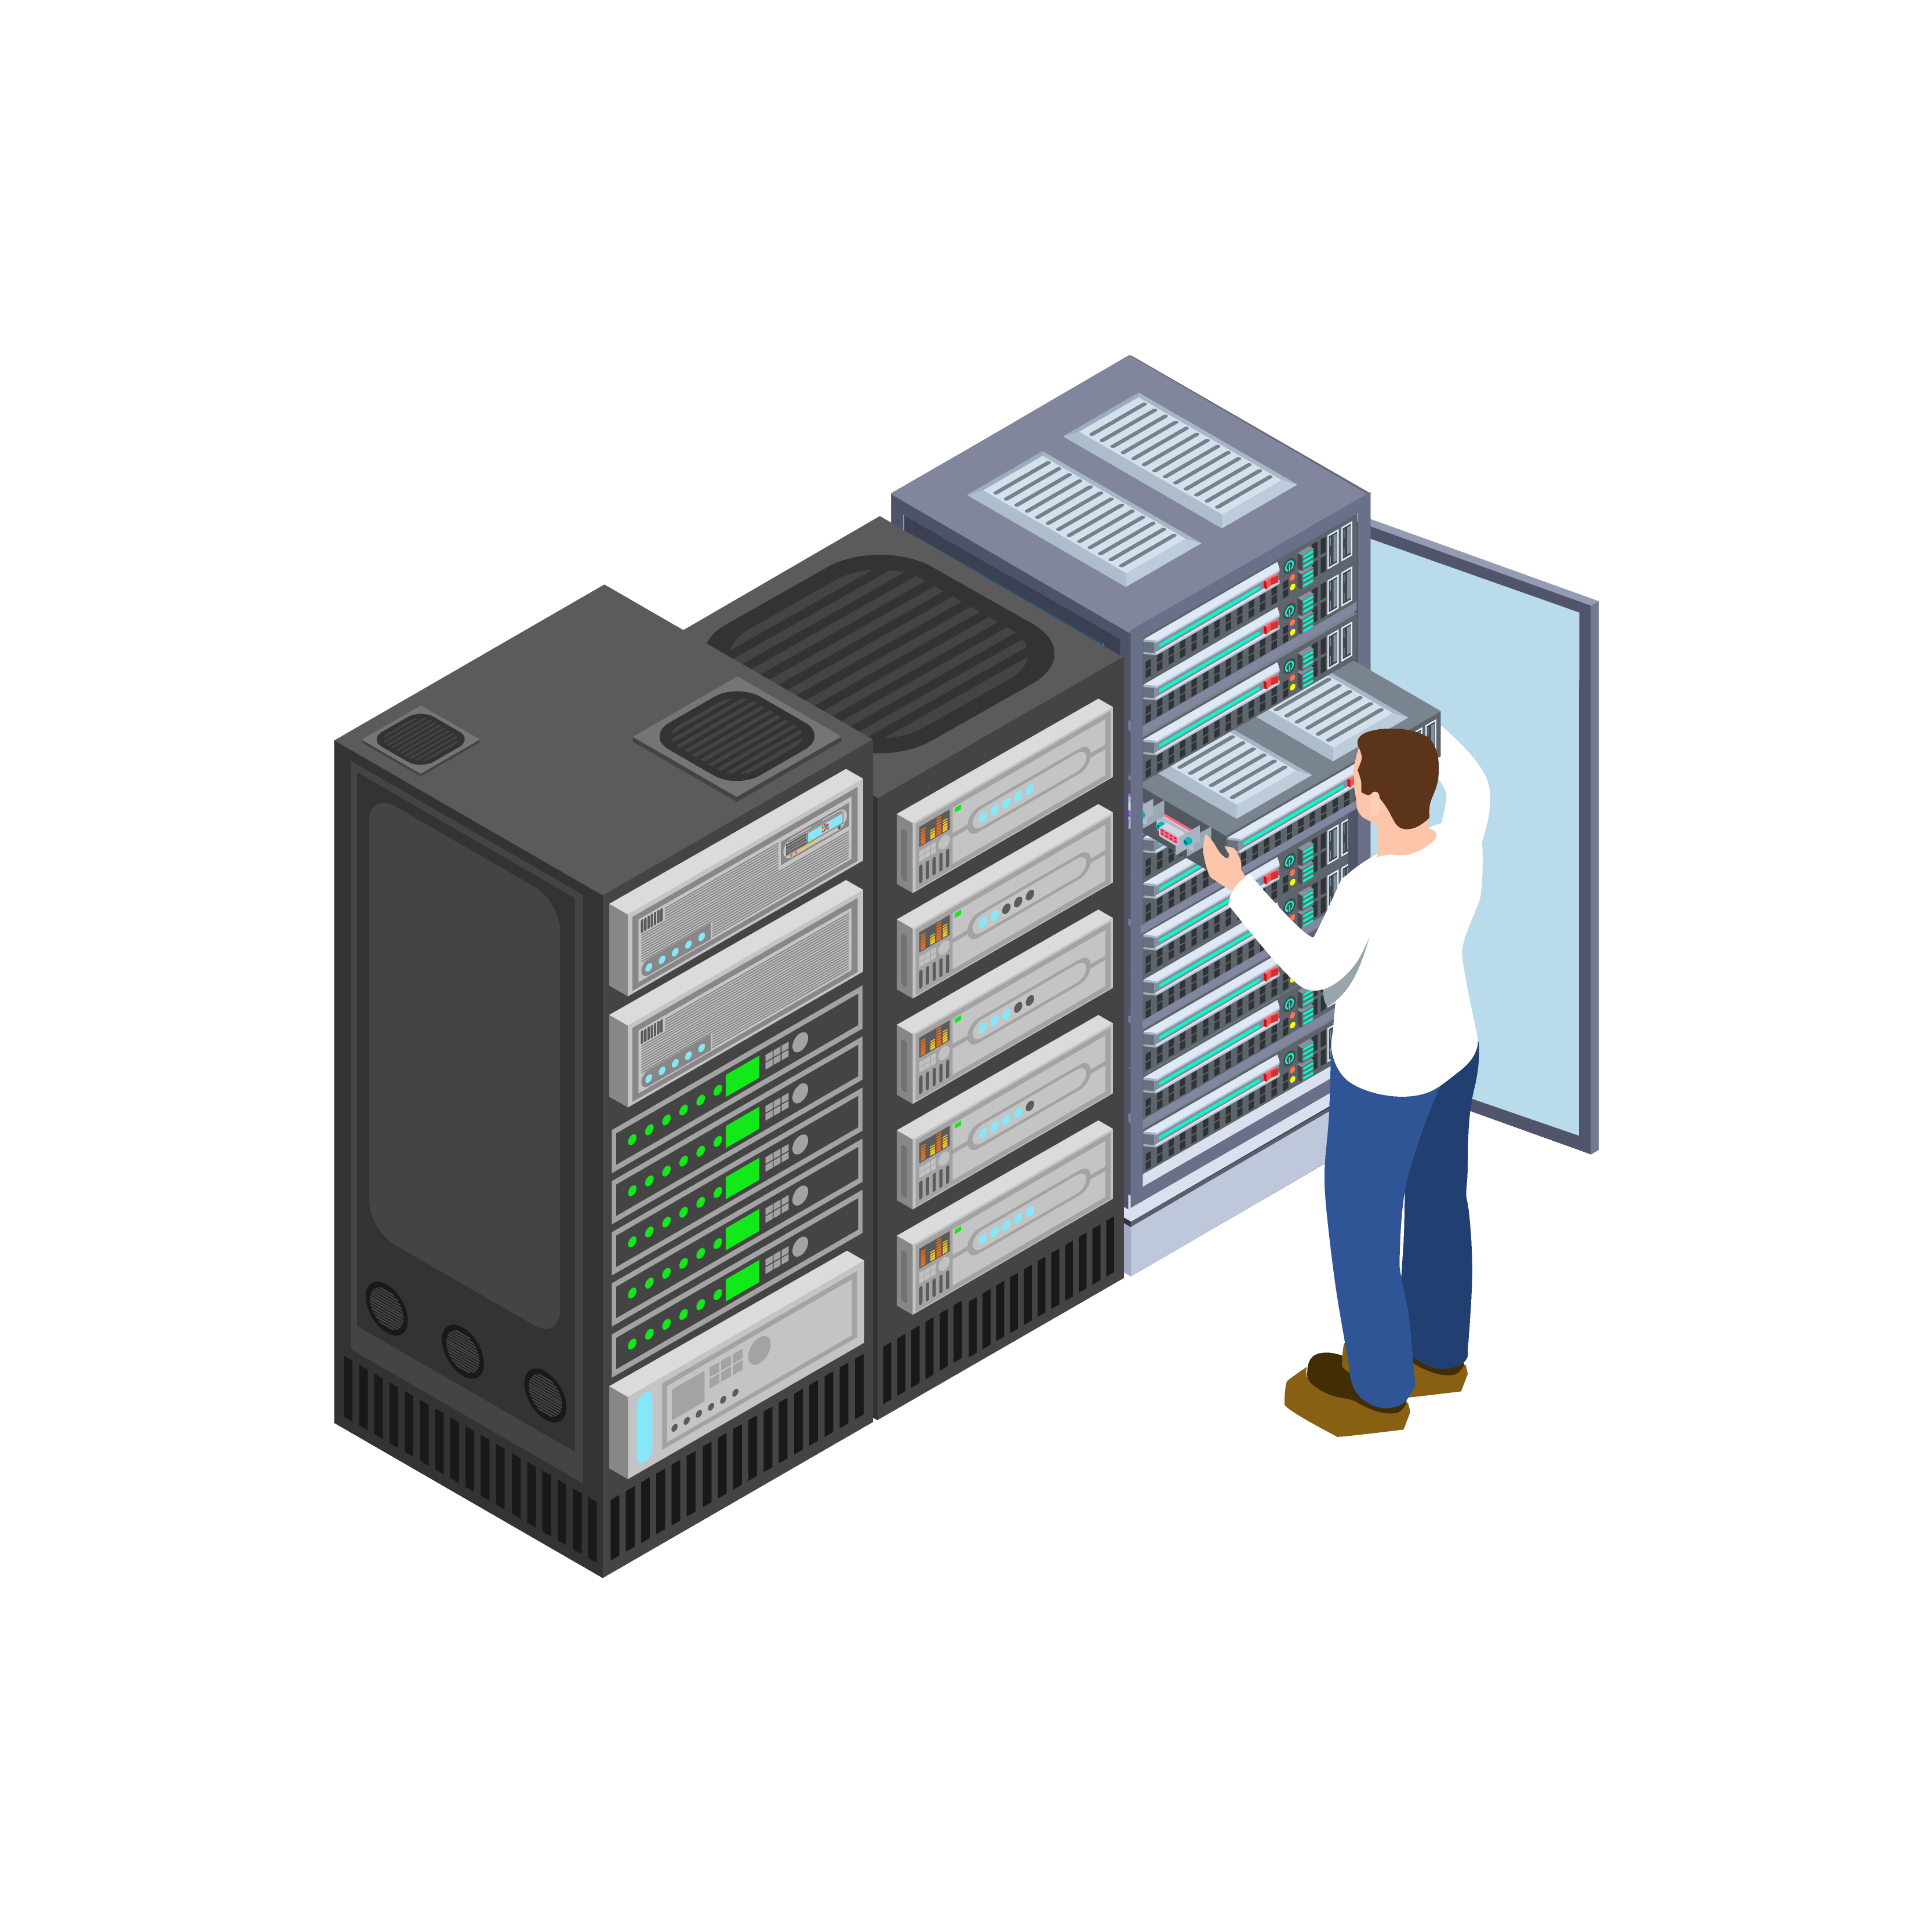
Servers
The Backbone of the Digital World

Slide 5
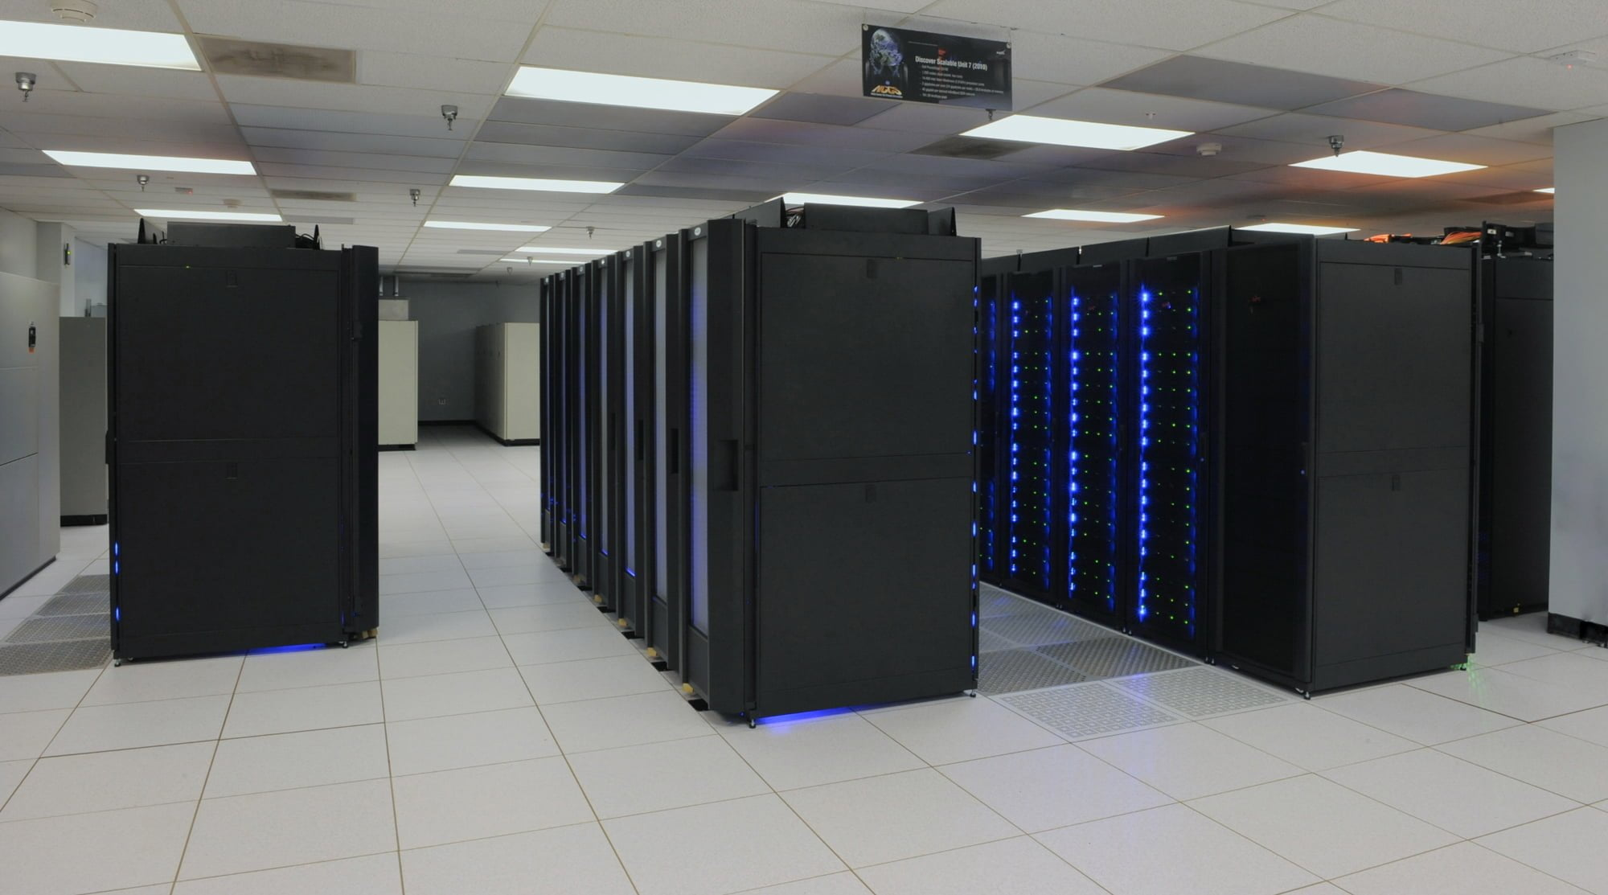
Mainframes
Powering Large-scale Operations

Slide 6
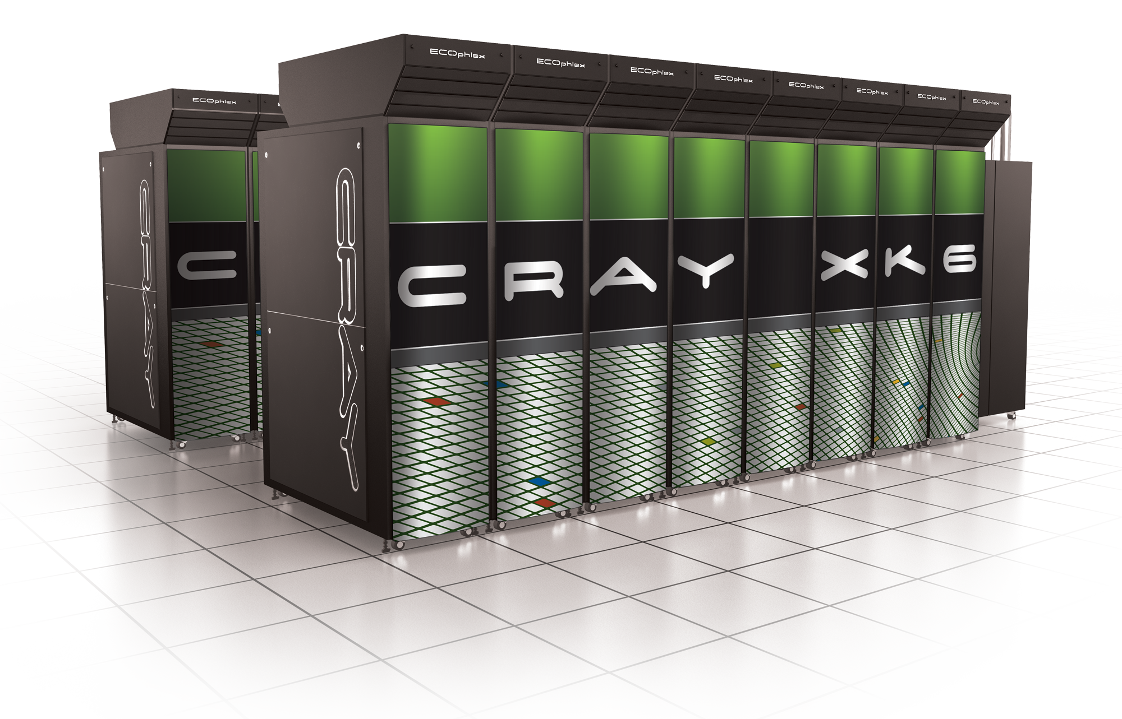
Supercomputers
Unleashing Computational Power

Slide 7
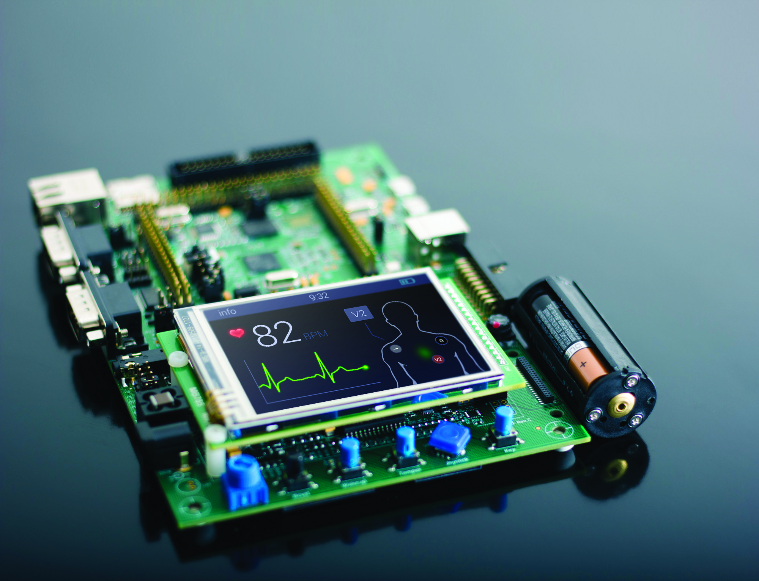
Embedded Systems
Computing in Everyday Life

Slide 8
Thank you for your attention!

